Slide 1
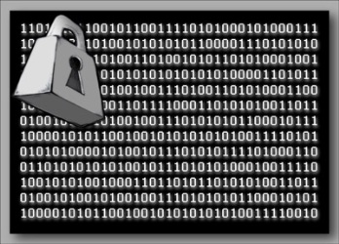
Introduction to Cryptography (Algorithms and Protocols)
Notes:
https://en.wikipedia.org/wiki/Authenticated_encryption
https://unicode-table.com/en/

Slide 2
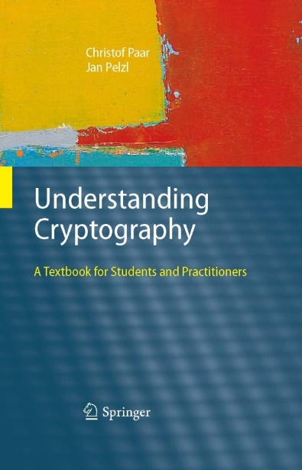
Acknowledgement
These slides are based on the following resources (but modified):
Slides accompanying the textbook ‘Understanding Cryptography’ by
Christof Paar and Jan Pelzl
http://crypto-textbook.com/
Slides from Dr. Ryan Riley
https://vsecurity.info/

Slide 3
Outline
Introduction to Cryptography
Caesar Cipher
Substitution Cipher
One-Time Pad Cipher
Notes:
Overview on the field of cryptology
Basics of symmetric cryptography
Cryptanalysis

Slide 4
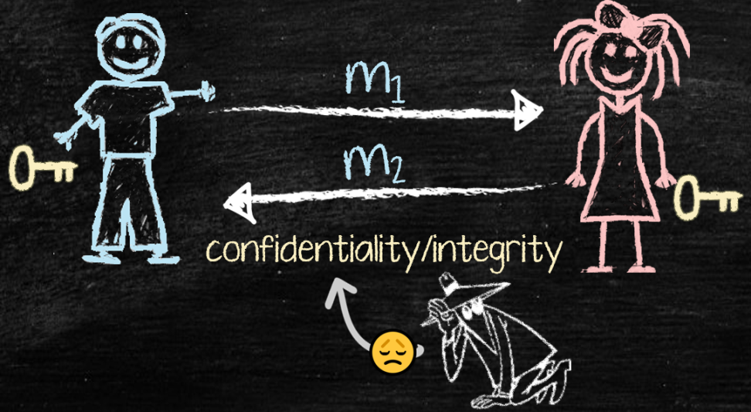
Introduction to Cryptography

Slide 5
Definition
The word Cryptography is Greek
Crypto = Secret + Graphy = Writing
Method to send secret messages using a key
Basic goal is secure communication
Send messages that no one but the expected recipient can read
Many other applications such as:
Cryptocurrency, Blockchains
Authentication
Digital signatures
…
Notes:
Has so many other applications, though!
Message sent via unsecure channel (e.g. Internet)
A malicious third party has channel access but should not be able to understand the exchanged messages
Secure communication
Unsecure
channel
(e.g. Internet)

Slide 6
Terminology
Plaintext(P): A message in its original form
Ciphertext(C): A message in encrypted form
Encryption: Transforming P to C
Decryption: Transforming C to P
Encryption Algorithm / Cipher: The method used for encryption

Slide 7


Symmetric Cryptography
Alternative names: private-key, single-key or secret-key cryptography.
Eve (bad guy)
Unsecure channel (e.g. Internet)
Alice
P
P
Bob
Problem Statement: 1) Alice and Bob would like to communicate via an unsecure channel (e.g., Internet) 2) A malicious third party Eve (the bad/evil guy) has channel access but should not be able to understand the exchanges messages
7

Slide 8
Symmetric Cryptography
Solution: Encryption with symmetric cipher. ⇒ Eve obtains only ciphertext C, that looks like random bits
Eve (bad guy)
Unsecure channel (e.g. Internet)
C
Alice
Encryption e( )
Decryption d( )
Bob
P
C
P
K
K
P is the. plaintext
C is the ciphertext
K is the key
Set of all keys {K₁, K₂, ...,K_{n}} is the key space
Secure Channel
8
Notes:
Key Generator

Slide 9
Symmetric Cryptography
Encryption equation C = e_{K}(P)
Decryption equation P = d_{K}(C)
Encryption and decryption are inverse operations if the same key K is used on both sides:
d_{K}(C) = d_{K}(e_{K}(P)) = P
Important: The key must be transmitted via a secure channel between Alice and Bob.
The secure channel can be realized, e.g., by a human courier (e.g. DHL) or a secure key exchange mechanism (this will be covered later)
However, the system is only secure if an attacker does not learn the key K!
⇒ The problem of secure communication is reduced to secure transmission and storage of the key K
9
Notes:
by manually installing the key for the Wi-Fi Protected Access (WPA) protocol

Slide 10
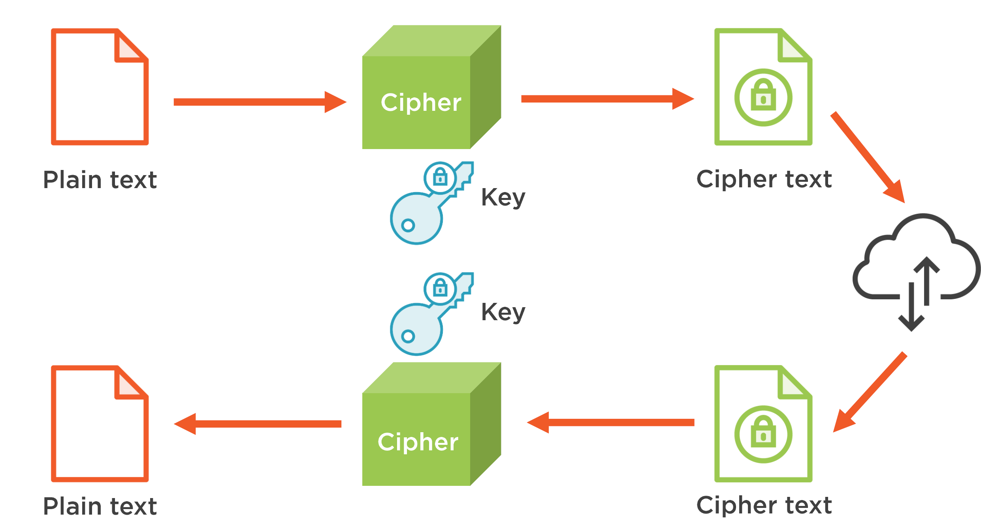
Symmetric Cryptography - Summary

Slide 11
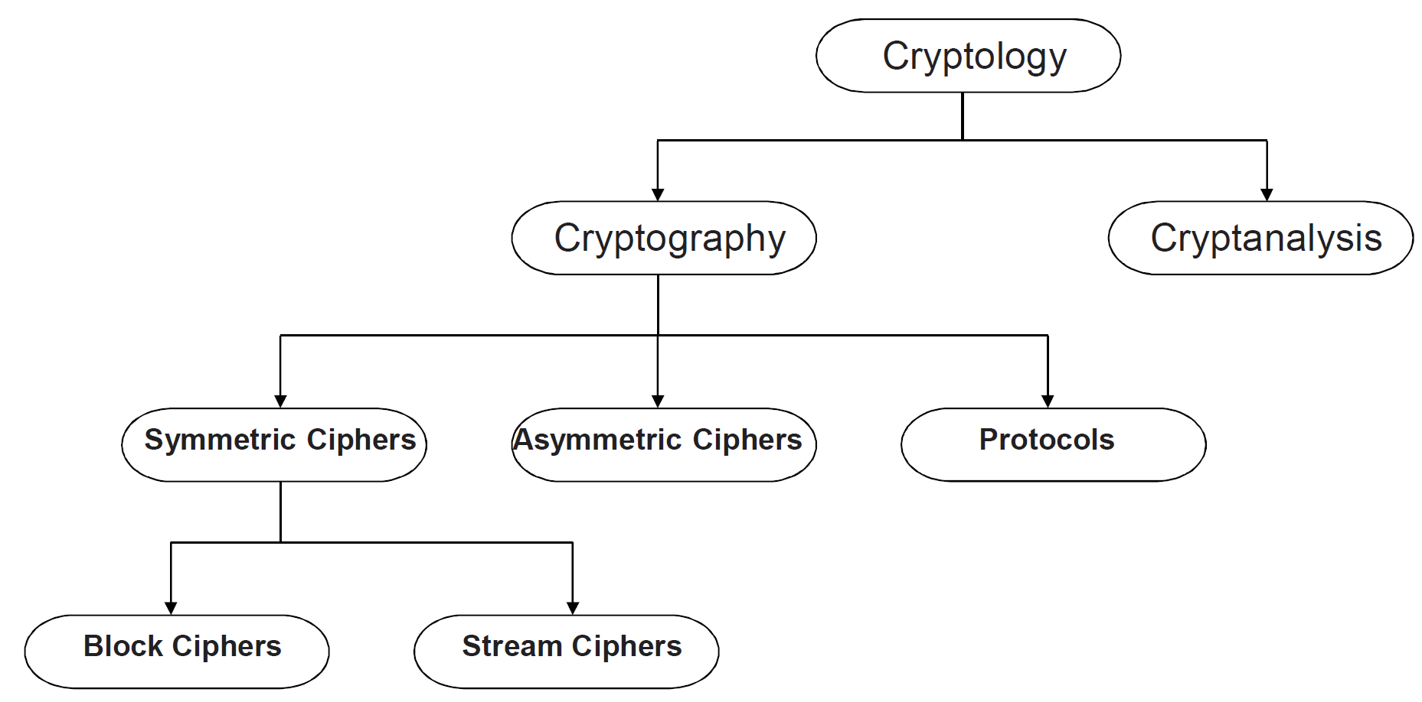
Classification of the Field of Cryptology
Cryptanalysis = Trying to break the key and read enrypted messages
Chapter 1 of Understanding Cryptography by Christof Paar and Jan Pelzl

Slide 12
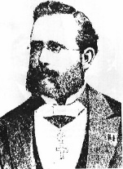
Why do we need Cryptanalysis?
There is no mathematical proof of security for any practial cipher
The only way to have assurance that a cipher is secure is to try to break it (and fail) !
We let lots of really smart people(hackers) try to break it (cryptanalysis). If they can’t, we assume it is secure
But… We might be wrong
Kerckhoff Principle is paramount in modern cryptography:
A cryptosystem should be secure even if the attacker knows all details about the system, with the exception of the secret key
In order to achieve Kerckhoff‘s Principle in practice: Only use widely known ciphers that have been cryptanalyzed for several years by good cryptographers!
Remark: It is tempting to assume that a cipher is “more secure“ if its details are kept secret. However, history has shown time and again that secret ciphers can almost always be broken once they have been reversed engineered. (e.g. Content Scrambling System (CSS) for DVD content protection.)
12
Notes:
(Understanding Cryptography only treats such ciphers)
There is no mathematical proof of security for any practical cipher
The only way to have assurance that a cipher is secure is to try to break it (and fail) !
Classical Attacks
Mathematical Analysis
Brute-Force Attack
Implementation Attack: Try to extract key through reverese engineering or power measurement, e.g., for a banking smart card.
Social Engineering: E.g., trick a user into giving up her password

Slide 13

Kerckhoff’s Principle
Security of a Cryptographic Algorithm should rely
ONLY on the secrecy of the KEYS, and
NOT on the secrecy of the METHOD used.
→“Do not rely on security through obscurity”
Notes:
Lesson 2: algorithm is public, key is secret!

Slide 14
Brute-Force Attack (or Exhaustive Key Search) against Symmetric Ciphers
Treats the cipher as a black box
Requires (at least) 1 plaintext-ciphertext pair (P₀, C₀)
Check all possible keys until condition is fulfilled:
d_{k}(C₀) = P₀
Key length in bit | Key space | Security life time
64 | 2⁶⁴ | Short term (few days or less)
128 | 2¹²⁸ | Long-term (several decades in the absence of quantum computers)
256 | 2²⁵⁶ | Long-term (also resistant against quantum computers – note that QC do not exist at the moment)
Notes:
(assuming brute-force as best possible attack)
and might never exist
Important: An adversary only needs to succeed with one attack. Thus, a long key space does not help if other attacks (e.g., social engineering) are possible..

Slide 15
Short Introduction to Modular Arithmetic
Why do we need to study modular arithmetic?
Extremely important for asymmetric cryptography (RSA, elliptic curves etc.)
Some historical ciphers can be elegantly described with modular arithmetic (cf. Caesar and affine cipher later on).

Slide 16
Short Introduction to Modular Arithmetic
Generally speaking, most cryptosytems are based on sets of numbers that are
discrete (sets with integers are particularly useful)
finite (i.e., if we only compute with a finiely many numbers)
Seems too abstract? --- Let‘s look at a finite set with discrete numbers we are quite familiar with: a clock.
12
11
1
10
2
9
3
8
4
7
5
6
Interestingly, even though the numbers are incremented every hour we never leave the set of integers:
1, 2, 3, … 11, 12, 1, 2, 3, … 11, 12, 1, 2, 3, …:

Slide 17
Short Introduction to Modular Arithmetic
We develop now an arithmetic system which allows us to compute in finite sets of integers like the 12 integers we find on a clock (1,2,3, … ,12).
It is crucial to have an operation which “keeps the numbers within limits“, i.e., after addition and multiplication they should never leave the set (i.e., never larger than 12).
Definition: Modulus Operation
Let a, r, m be integers and m > 0. We write
a ≡ r mod m
if (r-a) is divisable by m.
“m” is called the modulus
“r” is called the remainder
Examples for modular reduction.
Let a= 12 and m= 9 : 12 ≡ 3 mod 9
Let a= 37 and m= 9: 34 ≡ 7 mod 9
Let a= -7 and m= 9: -7 ≡ 2 mod 9
(you should check whether the condition „m divides (r-a)“holds in each of the 3 cases)

Slide 18
Properties of Modular Arithmetic (1)
The remainder is not unique
It is somewhat surprising that for every given modulus m and number a, there are (infinitely) many valid remainders. Example:
12 ≡ 3 mod 9 → 3 is a valid remainder since 9 divides (3-12)
12 ≡ 21 mod 9 → 21 is a valid remainder since 9 divides (21-12)
12 ≡ -6 mod 9 → -6 is a valid remainder since 9 divides (-6-12)

Slide 19
Properties of Modular Arithmetic (2)
Which remainder do we choose?
By convention, we usually agree on the smallest positive integer r as remainder. This integer can be computed as
a = q m + r where 0 ≤ r ≤ m-1
Example: a=12 and m= 9
12 = 1 x 9 + 3 → r = 3
Remark: This is just a convention. Algorithmically we are free to choose any other valid remainder to compute our crypto functions.
quotient
remainder

Slide 20
Properties of Modular Arithmetic (3)
How do we perform modular division?
First, note that rather than performing a division, we prefer to multiply by the inverse. Ex:
b / a≡ b x a⁻¹ mod m
The inverse a⁻¹ of a number a is defined such that:
a a⁻¹ ≡ 1 mod m
Ex: What is 5 / 7 mod 9 ?
The inverse of 7 mod 9 is 4 since 7 x 4 ≡ 28 ≡ 1 mod 9, hence:
5 / 7 ≡ 5 x 4 = 20 ≡ 2 mod 9
How is the inverse compute?
The inverse of a number a mod m only exists if and only if:
gcd (a, m) = 1
(note that in the example above gcd(5, 9) = 1, so that the inverse of 5 exists modulo 9)
For now, the best way of computing the inverse is to use exhaustive search. In Chapter 6 of Understanding Cryptography we will learn the powerful Euclidean Algorithm which actually computes an inverse for a given number and modulus.
[gcd = Greatest Common Divisor]

Slide 21
Properties of Modular Arithmetic (4)
Modular reduction can be performed at any point during a calculation
Let’s look first at an example. We want to compute 3⁸ mod 7 (note that exponentiation is extremely important in public-key cryptography).
1. Approach: Exponentiation followed by modular reduction
3⁸ = 6561 ≡ 2 mod 7
Note that we have the intermediate result 6561 even though we know that the final result can’t be larger than 6.
2. Approach: Exponentiation with intermediate modular reduction
3⁸ = 3⁴ 3⁴ = 81 x 81
At this point we reduce the intermediate results 81 modulo 7:
3⁸ = 81 x 81 ≡ 4 x 4 mod 7
4 x 4 = 16 ≡ 2 mod 7
Note that we can perform all these multiplications without pocket calculator, whereas mentally computing 3⁸ = 6561 is a bit challenging for most of us.
General rule: For most algorithms it is advantageous to reduce intermediate results as soon as possible.

Slide 22
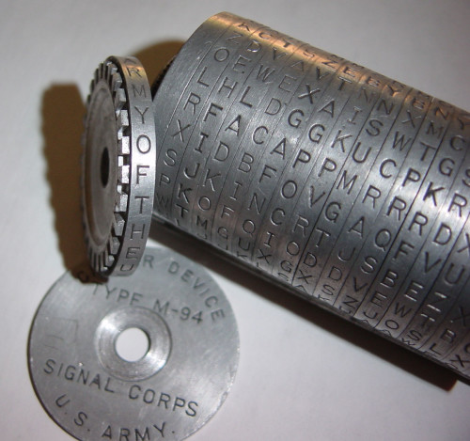
Caesar Cipher

Slide 23
Simple Ciphers
Originally, cryptography was performed by hand
Goal was to protect messages sent by couriers
From people who might intercept the courier
From the courier himself
War was a popular time to use them

Slide 24
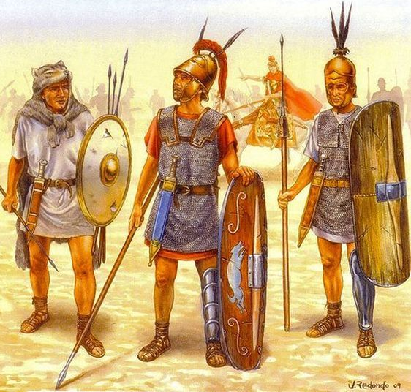
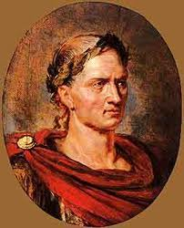

Caesar Cipher
Julius Ceasar (100-44 BC)
DWWDFN DW GDZQ
ATTACK AT DAWN
ATTACK AT DAWN
Encrypt the message!
Decrypt the ciphertext!
The sender and receiver must know something that the adversary doesn’t.
This is called a cryptographic key
24
Notes:
Greeks were also the originators of cryptography. Cryptography – kryptos (secret) + graphein (writing) – means secret writing.

Slide 25
Caesar Cipher
Secret key: A random number from {1,…,26}, say 3
DWWDFN DW GDZQ
Encryption
Message:
ATTACK AT DAWN
↓↓↓↓↓↓ ↓↓ ↓↓↓↓
DWWDFN DW GDZQ
Key: + 3
Ciphertext:

Slide 26
Caesar Cipher
Secret key: A random number from {1,…,26}, say 3
DWWDFN DW GDZQ
Decryption
Ciphertext:
DWWDFN DW GDZQ
Key: - 3
Message:
↓↓↓↓↓↓ ↓↓ ↓↓↓↓
ATTACK AT DAWN

Slide 27
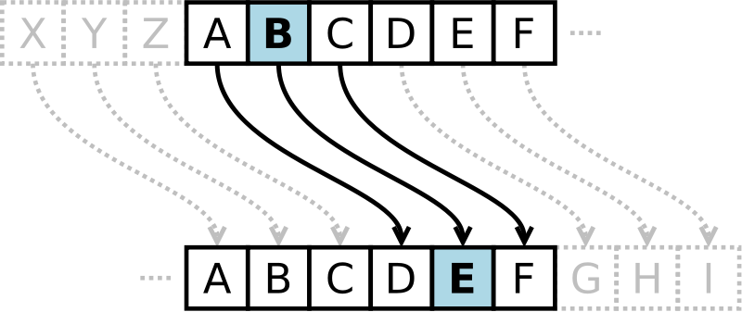
Caesar Cipher
Earliest documented cipher was used by Caesar in 50BC!
Each letter in a message is substituted by another that is 3 letters away
A becomes D, B becomes E, etc.
Note that the letters ”wrap around” at the end of the alphabet, which can be mathematically expressed using mod 26

Slide 28
Caesar Cipher Example
A | B | C | D | E | F | G | H | I | J | K | L | M | N | O | P | Q | R | S | T | U | V | W | X | Y | Z
0 | 1 | 2 | 3 | 4 | 5 | 6 | 7 | 8 | 9 | 10 | 11 | 12 | 13 | 14 | 15 | 16 | 17 | 18 | 19 | 20 | 21 | 22 | 23 | 24 | 25
ATTACK AT DAWN
DWWDFN DW GDZQ
Notes:
DWWDFN DW GDZQ

Slide 29
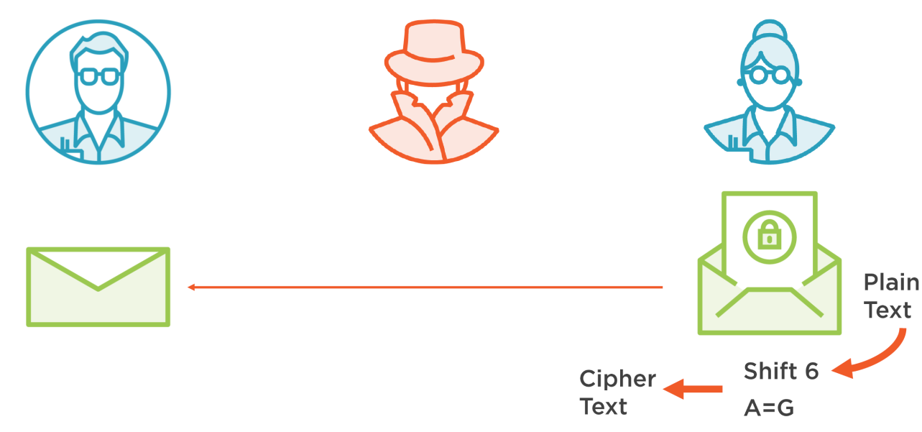
Shift Cipher
Generic version of Caesar cipher
Each letter is shifted by N. In Caesar, N=3
Let k, x, y ε {0,1, …, 25}
Encryption: y = e_{k}(x) ≡ x + k mod 26
Decryption: x = d_{k}(x) ≡ y - k mod 26

Slide 30
Shift Cipher: Example
A | B | C | D | E | F | G | H | I | J | K | L | M | N | O | P | Q | R | S | T | U | V | W | X | Y | Z
0 | 1 | 2 | 3 | 4 | 5 | 6 | 7 | 8 | 9 | 10 | 11 | 12 | 13 | 14 | 15 | 16 | 17 | 18 | 19 | 20 | 21 | 22 | 23 | 24 | 25
Let’s do one for N=10…
ATTACK AT DAWN
KDDKMU KD NKGX
Notes:
KDDKMU KD NKGX
Just wrap around

Slide 31
Shift Cipher Cryptanalysis
How do we break this?
Brute-force: Try all possible values for N
There are only 26
Feasibility?
Easy by hand
Trivial by computer
You can write program that tries different values of N

Slide 32
Substitution Cipher

Slide 33
Substitution Cipher
A | B | C | D | E | F | G | H | I | J | K | L | M | N | O | P | Q | R | S | T | U | V | W | X | Y | Z
Q | R | A | W | G | N | C | X | M | B | V | L | Z | D | S | J | T | E | K | Y | F | U | I | P | O | H
Generate a random set of substitutions for each letter
Always a 1:1 correspondence

Slide 34
Substitution Cipher Example
A | B | C | D | E | F | G | H | I | J | K | L | M | N | O | P | Q | R | S | T | U | V | W | X | Y | Z
Q | R | A | W | G | N | C | X | M | B | V | L | Z | D | S | J | T | E | K | Y | F | U | I | P | O | H
ATTACK AT DAWN
QYYQAV QY WQID
Notes:
QYYQAV QY WQID

Slide 35
Substitution Cipher Cryptanalysis
Brute-force: Try all possible letter combinations
There are (26!) = 403291461126605635584000000
Exhaustive key search will take a long time …
Letter frequency analysis attack can be used against the substitution cipher
Notes:
The secret is no more the offset
Given an arbitrary long cyphertext, the secret key requests the following number of guesses 26!

Slide 36
Substitution Cipher Cryptanalysis
QYYQAV QY WQID
Key observation: In a substitution cipher, basic language features are preserved
You can tell how often a letter occurs in the message
You can see when letters repeat
Etc.
Use a technique called frequency analysis

Slide 37
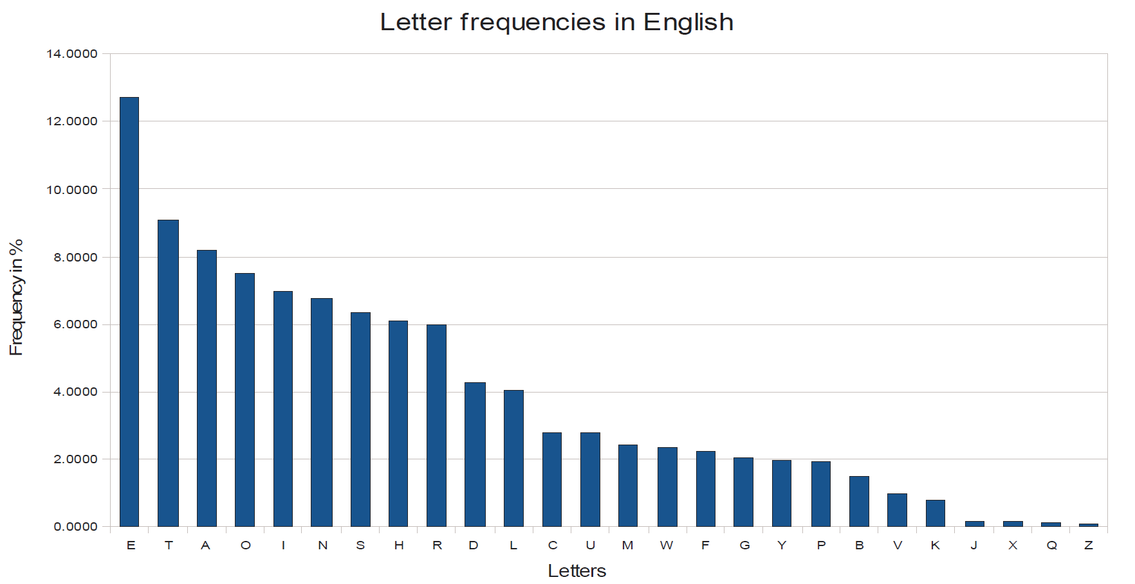
Frequency Analysis
Not all letters in a language occur with the same frequency. E.g., In English,
E is most common
Vowels are about 40%
Vowels tend to be separated by consonants
Q tends to be followed by U
Etc.
Notes:
http://pi.math.cornell.edu/~mec/2003-2004/cryptography/subs/frequencies.html
A cryptanalysis technique discovered by Al-Kindi in Iraq
In practice, not only frequencies of individual letters can be used for an attack, but also the frequency of letter pairs (i.e., “th“ is very common in English), letter triples, etc.

Slide 38
Breaking the Substitution Cipher with Letter Frequency Attack
Let‘s take an example and identify the most frequent letter:
iq ifcc vqqr fb rdq vfllcq na rdq cfjwhwz hr bnnb hcc hwwhbsqvqbre hwq vhlq
We replace the ciphertext letter q by E and obtain:
iE ifcc vEEr fb rdE vfllcE na rdE cfjwhwz hr bnnb hcc hwwhbsEvEbre hwE vhlE
By further guessing based on the frequency of the remaining letters we obtain the plaintext:
WE WILL MEET IN THE MIDDLE OF THE LIBRARY AT NOON ALL ARRANGEMENTS ARE MADE
In practice, not only frequencies of individual letters can be used for an attack, but also the frequency of letter pairs (i.e., “th“ is very common in English), letter triples, etc.
38

Slide 39
Vigenère Cipher
(1900-1950)
Poly-alphabetic cipher
One plaintext letter can become different ciphertext letters
Poly = many
Uses a text based key and modulo arithmetic to perform the encryption
Frequency analysis is possible, but much more difficult

Slide 40
Vigenère Cipher: Example
A | B | C | D | E | F | G | H | I | J | K | L | M | N | O | P | Q | R | S | T | U | V | W | X | Y | Z
0 | 1 | 2 | 3 | 4 | 5 | 6 | 7 | 8 | 9 | 10 | 11 | 12 | 13 | 14 | 15 | 16 | 17 | 18 | 19 | 20 | 21 | 22 | 23 | 24 | 25
Let’s choose a key of “MONKEY”
ATTACK AT DAWN
MONKEY MO NKEY
MHGKGI MH QKAL

Slide 41
One-Time Pad Cipher

Slide 42
One-Time Pad
Vigenère cipher with a randomly chosen key as long as the message
Key needs to be shared between parties beforehand
Key can never be re-used
Provable unbreakable without the key
This is the only perfect cryptography

Slide 43
One-Time Pad: Example
A | B | C | D | E | F | G | H | I | J | K | L | M | N | O | P | Q | R | S | T | U | V | W | X | Y | Z
0 | 1 | 2 | 3 | 4 | 5 | 6 | 7 | 8 | 9 | 10 | 11 | 12 | 13 | 14 | 15 | 16 | 17 | 18 | 19 | 20 | 21 | 22 | 23 | 24 | 25
A | B | C | D | E | F | G | H | I | J | K | L | M | N | O | P | Q | R | S | T | U | V | W | X | Y | Z
26 | 27 | 28 | 29 | 30 | 31 | 32 | 33 | 34 | 35 | 36 | 37 | 38 | 39 | 40 | 41 | 42 | 43 | 44 | 45 | 46 | 47 | 48 | 49 | 50 | 51
Our random key is “FOWIFOZMQOAF”
ATTACK AT DAWN
FOWIFO ZM QOAF
FHPIHY ZF TOWS

Slide 44
One-Time Pad
Perfect Secrecy is guaranteed by the One-time Pad
Unconditionally secure cryptosystem:
A cryptosystem is unconditionally secure if it cannot be broken even with infinite computational resources
THE GOOD: Unbreakable regardless of the power of the adversary
THE BAD: Impractical! Needs very, very long shared keys

Slide 45
Crypto Components
All of the previous techniques have two basic components:
Algorithm (What you do to the message)
Key (The secret that you need in order to encrypt/decrypt properly)
When using these algorithms, the key is secret
The algorithm is not

Slide 46
Summing Up
We trust a cryptographic algorithm if lots of smart people can’t break it
We looked at three types of simple ciphers:
Shift Cipher
Substitution Cipher
One-Time Pad Cipher
They each have an algorithm and a key
Long key is required for cryptographic algorithms in order to prevent exhaustive key-search attacks
Notes:
Cryptography is a type of mathematics dedicated to secret codes
Vigenère Cipher
64 bit: insecure except for data with extremely short-term value
128 bit: long-term security of several decades, unless quantum computers become available
256 bit: as above, but probably secure against attacks by quantum computers

Slide 47
Resources
Cryptool - Software demonstrating many ancient and modern ciphers
https://www.cryptool.org/en/
An excellent one-hour video summarizing the last 40 years of modern cryptography by Ron Rivest
The International Association of Cryptographic Research is the professional organization of cryptographers.

